Slide 1


PROJECT
REPORT
INSTITUTE OF ENGINEERING AND MANAGEMENT, KOLKATA
Group - 15
Presented by: Team Members

Slide 2
CONTENT BASED MOVIE RECOMMENDATION APP
ENROLLMENT
NUMBER
12020002018011
12020002018012
12020002018013
12020002018016
12020002018017
12020002018018
GROUP MEMBERS
Arnab Sadhukhan Abhishek Kumar Raushan Kumar Abhisikt Jha Nitish Kumar
Saptak Dutta
STREAM
CSBS CSBS CSBS CSBS CSBS
CSBS

Slide 3

We haven't done this without the consent of our beloved
teacher,
our project guide- Mr Mrityunjay Sen sir.

Slide 4
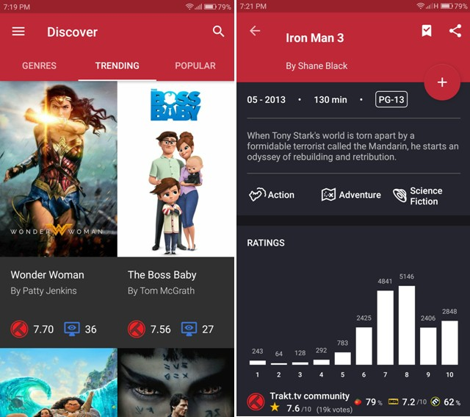
sample image

Slide 5
ABSTRACT
Recommendation systems have become extremely common in recent years.The system recommends personalised sets of videos to users based on their activity on the site. It is a software tool and techniques that provide suggestions based on the customer's taste to discover new appropriate things for them by filtering personalised information based on the user's preferences from a large volume of information.
Content-based filtering is a type of recommender system that attempts to guess what a user may like based on that user’s activity.
Content-based filtering makes recommendations by using keywords and attributes assigned to objects in a database (e.g., items in an online marketplace) and matching them to a user profile.

Slide 6
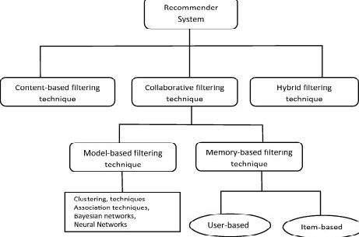
INTRODUCTION

Slide 7
Recommendation system has been seen to be very useful for user to select an item amongst many. It produces a ranked list of items on which a user might be interested, in the context of his current choice of an item. It helps the user to address the problem of information overload and finds the relevant objects for user. Recommendation system has been built for movies, book, communities, news, articles etc. There are two main approaches to build a recommendation system- collaborative filtering and content based.
Collaborative filtering recommenders use the opinions of other users to predict the value of items for each user in the community. Whereas content-based recommendation systems recommend on basis of the content similarity between objects. A hybrid recommender system also can be built by combining collaborative filltering and content based system.Content-based recommendation systems are very much useful when there is no or very less user data available.
In that case depending on the similarity between the items the system recommends. The similarity of the content of the items is measured. To find this similarity various machine learning techniques
(supervised or unsupervised) can be applied.

Slide 8
ON PURPOSED THOUGHT
We will develop an application in which user can maintain a catalogue of content they consume. User can also rate the contents. We will enable them to write review about the contents.
The application will recommend them similar content based on their rating and details of contents.Users will also be shown the trending movie list. They can even create their own playslist.We will store the fetched data in google Firebase.
For example, if a user watched a SRK movie and rated it 4/5 stars.
Then, application will suggest them movies, songs, etc. of same genres or a movie starring SRK.
(Realtime Database lets you build rich, collaborative applications by allowing secure access to the database directly from client- side code)

Slide 9
RELATED WORK
The recommender system was defined from the perspective of E- commerce as a tool that helps users search through records of knowledge which is related to users’ interest and preference.
GroupLens is a news-based architecture which employs collaborative methods in assisting users to locate articles from massive news database.
Amazon uses topic diversification algorithms to improve its recommendation.

Slide 10
ALGORITHM
Basically, content-based filtering methods use an item profile (i.e., a set of discrete attributes and features) characterizing the item within the system. To abstract the features of the items in the system, an item presentation algorithm is applied. A widely used algorithm is the tf–idf representation (also called vector space representation). The system creates a content-based profile of users based on a weighted vector of item features. The weights denote the importance of each feature to the user and can be computed from individually rated content vectors using a variety of techniques.
Simple approaches use the average values of the rated item vector while other sophisticated methods use machine learning techniques such as Bayesian Classifiers, cluster analysis, decision trees, and artificial neural networks in order to estimate the probability that the user is going to like the item.

Slide 11
CONCLUSION
Recommender Systems opens new opportunities of retrieving personalized in- formation on the Internet. Recommendation Systems are the most popular type of machine learning applications that are used in all sectors. They are an im- provement over the traditional classification algorithms as they can take many classes of input and provide similarity ranking based algorithms to provide the user with accurate results. These recommendation systems have evolved over time and have incorporated many advanced machine learning techniques to pro- vide the users with the content that they want.. It also helps to alleviate the problem of information overload which is a very common phenomenon with in- formation retrieval systems and enables users to have access to products and services which are not readily available to users on the system.

Slide 12
REFERENCES:-
https://www.upwork.com/resources/what-is-content-based- filtering#:~:text=Content%2Dbased%20filtering%20is%20a,them%2 0to%20a%20user%20profile. https://en.wikipedia.org/wiki/Recommender_system
https://www.youtube.com/watch? v=1xtrIEwY_zY&t=2s&ab_channel=CampusX
https://developers.google.com/machine- learning/recommendation/content-based/basics

